Slide 1

Glasgow on the Go:
Visualising Urban Mobility in Glasgow
By Danial Sheikh

Slide 2
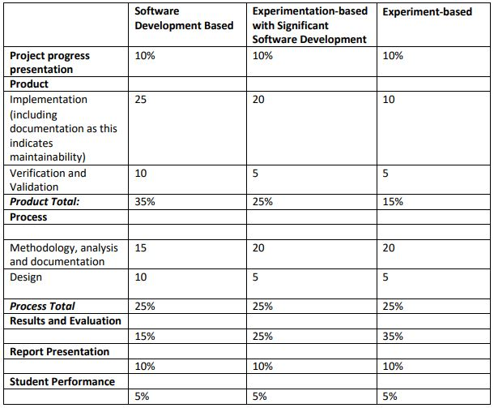
Project Information
Project supervisor: Fredrick Nordvall Forsberg
Second Marker: Alex Coddington
Marking Scheme: Software Development Based

Slide 3

Aims & Objectives
Aim
To monitor and visualise urban mobility within Glasgow in a clear and user-friendly way.
Objectives
Collect and display the data from the Glasgow Open Data hub APIs.
To develop and implement an interactive graph with analysis features.
To develop and implement an interactive map including zoom and analysis features.
Allow users to search for a specific date range when viewing the data.

Slide 4
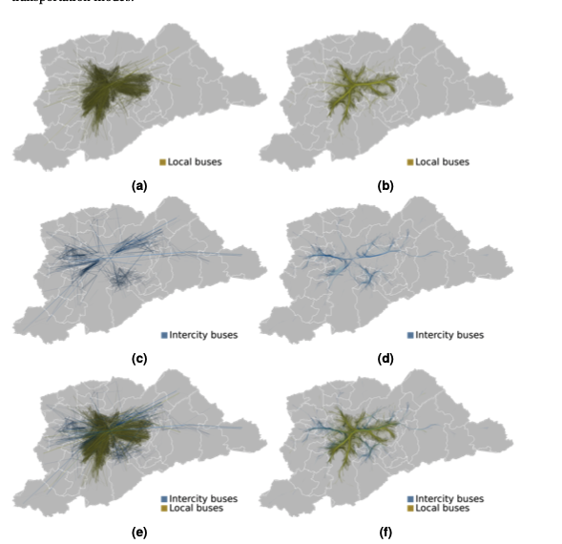
Summary of Related Work
“Visualising the structure of urban mobility with bundling”
Case study on São Paulo's urban mobility
Dealing with large urban mobility datasets.
Various techniques are used to analyse the data the main one being trail bundling.
A key difference is my project aims to visualise the data in a more user-friendly way.
Heatmaps used for plotting results can be too vague.

Slide 5

Project Specification (Part one)
Functional Requirements
The application will allow users to view an interactive map and graph of Glasgow.
Users will be able to see data on traffic, cyclists and pedestrians.
The map will update in real-time data becomes available from Glasgow Open Data Hub APIs
Users can interact with the map including zooming and analysis features.
It must be easy to navigate and visually appealing.
Non-Functional Requirements
The map and graph must load within ten seconds to ensure a responsive user experience.
It must be compatible with modern web browsers and mobile devices.
The application must ensure security of data and communications are protected against unauthorised access and data breaches.
The application should be accessible according to WCAG standards (Web Content Accessibility Guidelines).
Ensure Graph is downloadable for people wanting to use it for further work.

Slide 6
Project Specification (Part two)
System use cases
A user selects a location to view how view traffic trends for that area.
A user clicks on a pin on the map to get more details about footfall at a specific location.
The developer in charge of the application (me) should ensure the dataset information from the API is updated and reflected in real time on the map.
A user filters the data for a specific time period so they can study its impact on urban mobility.
User Stories
As a commuter, I want to check the traffic so I can avoid congested routes.
As a city planner, I want to understand peak footfall areas to better plan urban infrastructure.
As a health advocate, I want to find areas of high vehicle traffic and promote active travel initiatives.
As someone relocating to Glasgow, I would like to find the least congested parts of the city, so I can live in a noise free environment.

Slide 7
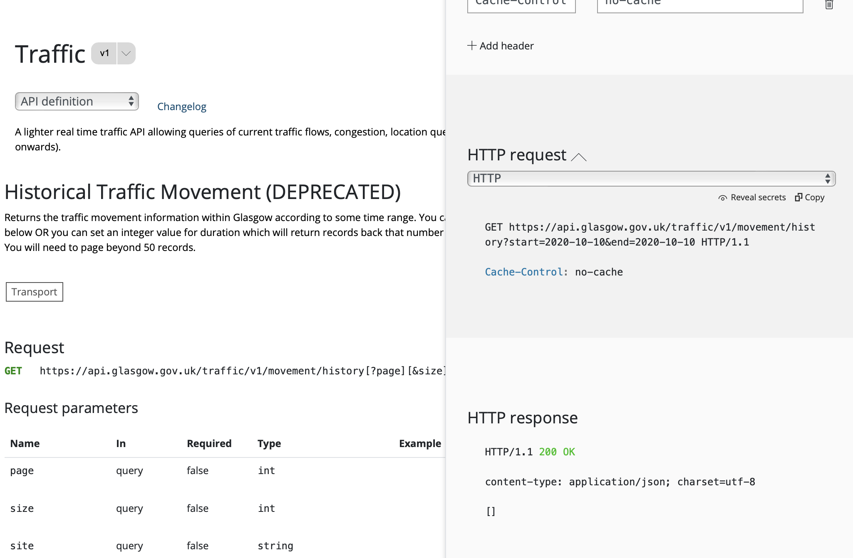
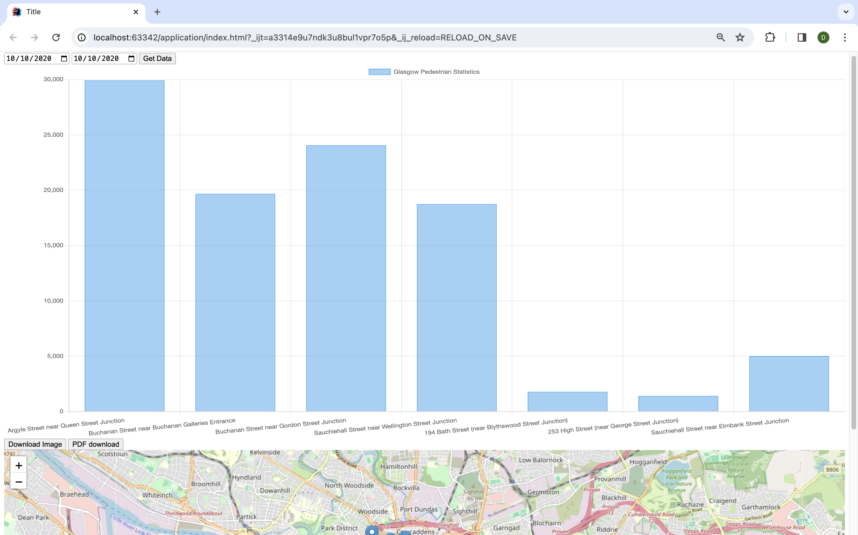
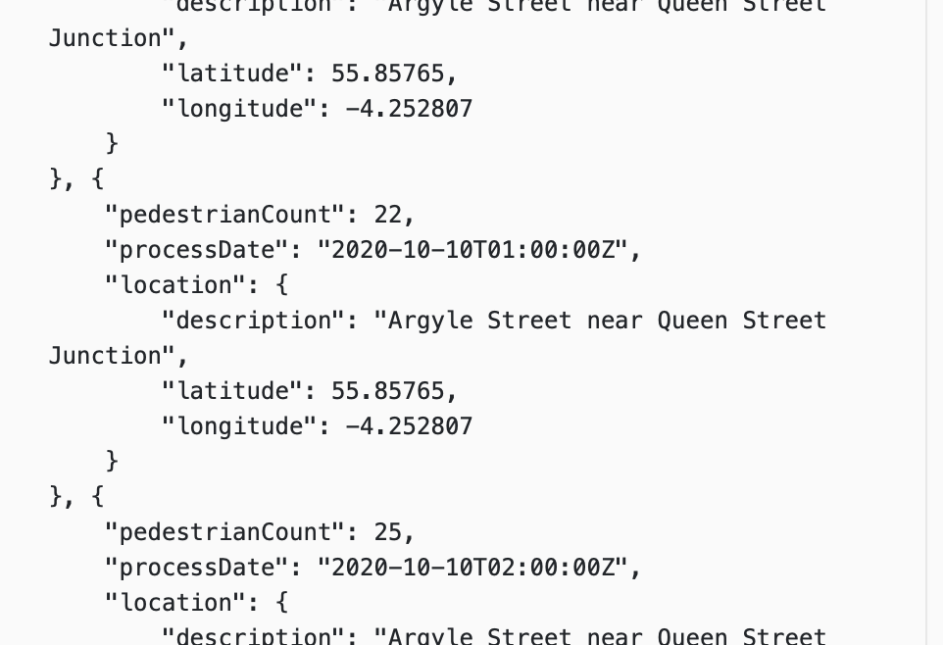

Progress to date

Slide 8




Approach to Development

Slide 9


Testing and Evaluation plans
Testing
Unit testing to ensure functions are correct.
Use an emulator to test devices
User Acceptance Testing
Evaluation
Evaluate performance metrics
Gather user feedback through surveys and interviews
Ensure functional requirements have been met

Slide 10

Thank you for listening, any questions?

